Slide 1
Evidence for the Theory of Evolution

Slide 2
Syllabus
Syllabus:
Evidence for the theory of evolution includes: comparative genomics (molecular evidence), the fossil record, comparative anatomy and embryology
Use examples to explain how comparative genomics and biochemistry, comparative anatomy and embryology provide evidence for the theory of evolution
Essential
Question:

Slide 3
What you need to complete
BIOLOGY WA UNITS 3&4
READ
Chapter 8 Mechanisms of Evolution and Speciation
Questions
Set 8.1 pg. 250 Q 1-5 Theory of Evolution
Set 8.2 pg. 254 Q 1-4 Biogeography
Set 8.3 pg. 260-261 Q 1-6 Bioinformatics, Comparative Genomics & Biochemistry, Phylogenetic trees
Set 8.4 pg. 268 Q 1-7 Fossils
Set 8.5 pg. 275 Q 1-7 Comparative Anatomy
BIOZONE
  226 Homologous Structures
  240 Patterns of Evolution
  227 Comparative Embryology
  240 Patters of Evolution
  241 – 242 Adaptive Radiation
  243 Convergent Evolution
  224 Comparative Genomics & DNA hybridisation
  225 Comparative Biochemistry
  233 Phylogenetic Species Concept
  229 Biogeography
  231 Continental Drift

Slide 4
Topic Question 1: Explain, using an example, how Biogeography can help scientists understand the distribution of species across different continents
Define Biogeography
Biogeography is the study of the distribution of organisms and ecosystems across the world and through geologic time.
Evidence of evolution
The fauna and flora of Australia owe their uniqueness to the isolation of the landmass.
However, Australia and other landmasses in the southern hemisphere share many plant and animal groups.
By looking at the pattern of these distributions today, plus that of the fossils, we are able to reconstruct Australia’s evolutionary history.

Slide 5
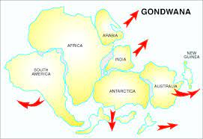
Topic Question 1: Explain, using an example, how Biogeography can help scientists understand the distribution of species across different continents
Example of Biogeography providing evidence of evolution
Southern beech trees, Nothofagus, are found as both living and fossil specimens in mainland Australia, Tasmania, Papua New Guinea, New Caledonia, New Zealand, Antarctica and South America.
The far-flung distribution of Nothofagus provides evidence that Gondwana once existed.

Slide 6
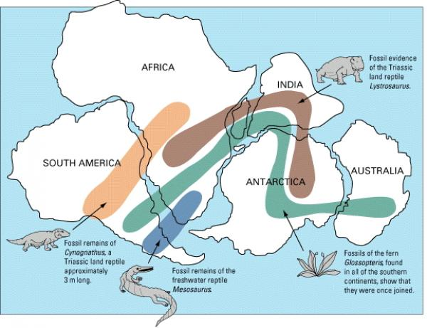

Slide 7
Evolution is the scientific explanation for the mechanisms that drive species to change over time.
A significant source of evidence for evolution comes from the fossil record.
The modern evolutionary synthesis combines evidence from the fossil record with our relatively modern knowledge of how genes are inherited and how changes to genes arise to give a complete picture of the mechanisms of evolution.

Slide 8
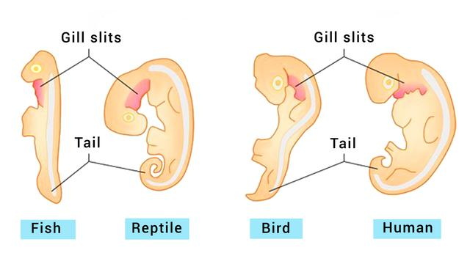
Topic Question 2: define Comparative embryology?
Comparative Embryology is the study of the structural similarities and differences of embryos of different organisms

Slide 9
Topic Question 3: Using examples, explain how is Comparative embryology provides evidence for the theory of evolution
  Evidence supporting the theory of evolution
  Embryological similarity may indicate common ancestry.
  Some vertebrates possess traits that are present in the embryos but are not present or obvious in the later stages of development.
  These traits do not have a function in the embryos but are present because they had a function in their ancestors.
  These traits provide evidence for evolution because they demonstrate the ancestry of the organism.

Slide 10
Topic Question 3: Using examples, explain how is Comparative embryology provides evidence for the theory of evolution
Example of comparative embryology
All members of the phylum Chordata (Vertebrates) have, at some stage of their development:
  a dorsal notochord (a solid tissue running along the back),
  pharyngeal slits (which turn into gill slits in fish),
  a dorsal nerve cord
  a tail that extends past the anus.
  The embryos of the different vertebrates are very similar and show features that are not present in adults.
  This suggests that these vertebrates evolved from a common aquatic ancestor, such as the crossopterygian fish.

Slide 11
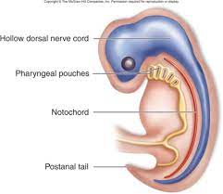

Slide 12
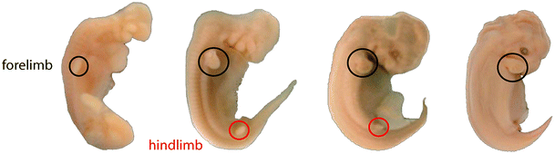
Topic Question 3: Using examples, explain how is Comparative embryology provides evidence for the theory of evolution
Example of comparative embryology
Whale/dolphin embryos along with having similarities as other vertebrate embryos have limb buds implying that they evolved from a land mammal.

Slide 13
Topic Question 4: Define comparative anatomy
Define comparative anatomy
Comparative anatomy is the study of the similarities and differences in structure between different organisms.
Anatomical structures that are common to more than one species – homologous structures are compared

Slide 14
Topic Question 5: Define Homologous structures
Anatomical structures that are common to more than one species and were inherited from a common ancestor, but have different functions, are known as homologous structures.

Slide 15
Topic Question 6: explain how is Comparative anatomy provides evidence for the theory of evolution
Comparative anatomy provides evidence for evolution
Homologous structures show the same structural plan but perform different functions due to the different species living in different environments with different selective pressures (conditions).
The shared physiological structures stem from their descent from a common evolutionary ancestor
This occurs through adaptive radiation – a process where a lineage of organisms rapidly diversify into many different forms
This is a type of divergent evolution – when related species evolve new traits over time, away from the common ancestor can give rise to new species.

Slide 16
Topic Question 7: Describe examples of Comparative anatomy and explain how they provide evidence of evolution
Examples of Homologous structures:
  Pentadactyl limb structure
  Scales on reptiles
  Leaves
  Vestigial Organs (see slide 21)

Slide 17
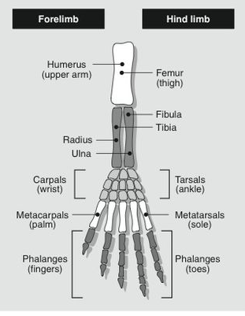
Topic Question 7: Describe examples of Comparative anatomy and explain how they provide evidence of evolution
The principle of homologous structures is illustrated by the adaptive radiation of the forelimb of a selection of vertebrates.
In each group it shows the basic pentadactyl pattern, but it has been modified for different uses.
The pentadactyl limb is a limb with 5 digits such as a human hand/foot and other vertebrates, which allows us to deduce animals with the basic pentadactyl pattern have a common ancestor.

Slide 18
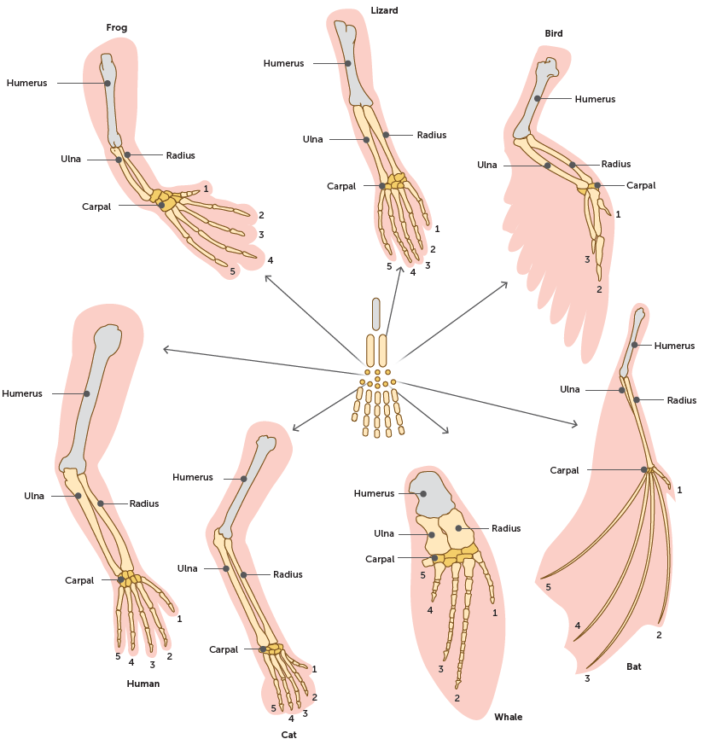

Slide 19
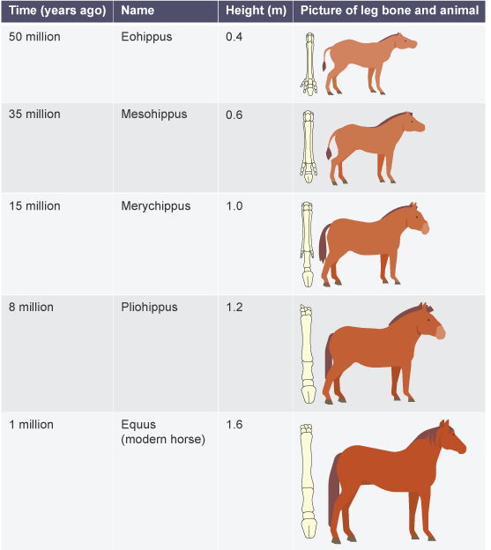
Topic Question 7: Describe examples of Comparative anatomy and explain how they provide evidence of evolution
The pentadactyl limb seen in the horse provides an excellent example of how evolution has happened.
As the marshy ground became drier, horses with smaller feet were generally faster. They had an evolutionary advantage because they were able to avoid predators.
Over many, many generations horse's feet have evolved to be smaller and the horses themselves taller and stronger.
https://www.bbc.co.uk/bitesize/guides/zsqydxs/revision/7

Slide 20
Topic Question 7: Describe examples of Comparative anatomy and explain how they provide evidence of evolution
In some cases, homologous structures stemming from a common descent can eventually cease to have any functional use for an organism; the structure may not necessarily impede a particular adaptation of an organism, but at the same time the structure no longer serves a ‘useful’ purpose.
These structures are called vestigial structures.
Vestigial structures can take a variety of forms, including bones, soft tissues, organs, cells or molecules.
Vestigial organs are evidence for evolution, because it is hypothesised that they were once present and functional in their ancestors. Changes in the environment have rendered these organs redundant, so over time they have lost their functionality.
They demonstrate the evolutionary divergence of a species from a past behaviour or activity.

Slide 21
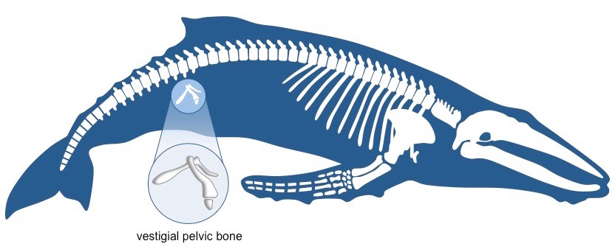
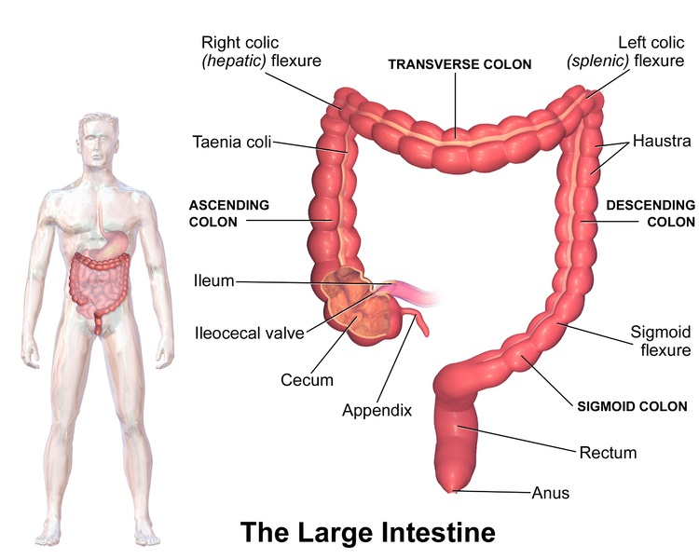
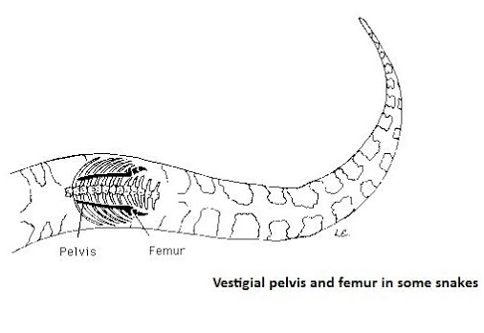
Topic Question 7: Describe examples of Comparative anatomy and explain how they provide evidence of evolution

Slide 22
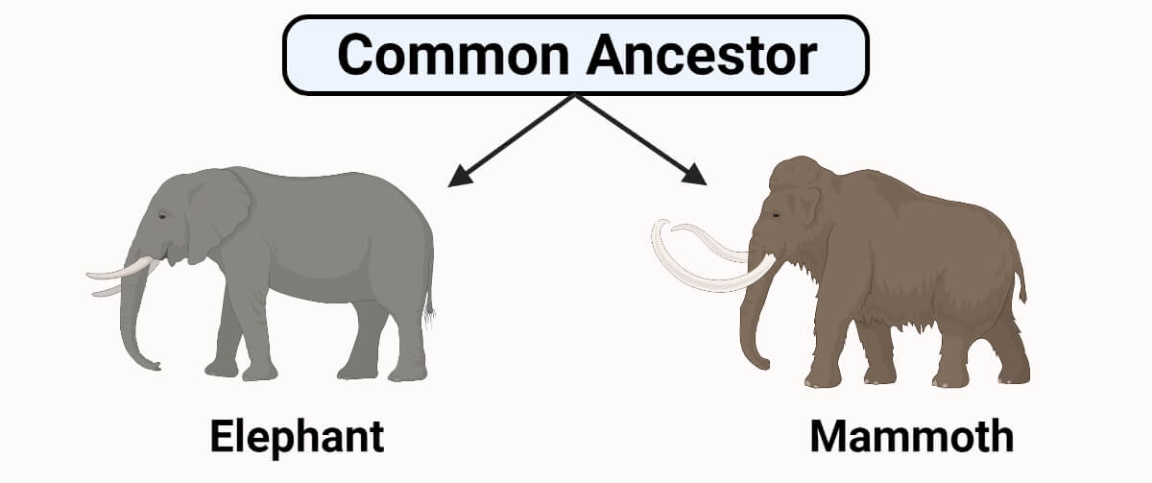
Recap: Define divergent evolution & provide examples of divergent evolution
Divergent evolution is a pattern of evolution in which differences between groups of organisms accumulate to a critical point that leads to speciation, the development of a new species.
This pattern is usually the result of the dispersal of a single species to different environments; that is, groups from the same species become isolated from one another, stopping gene flow.
The sub-populations are subjected to different environmental pressures, suited to certain structures that can perform functions specific to surviving their unique environment.
Homologous structures indicate divergent evolution, because new species will have the same fundamental structural plan, but the structures may be used in different ways.

Slide 23
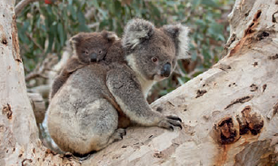
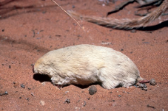
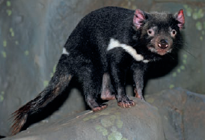
Recap: Define divergent evolution & provide examples of divergent evolution
Koalas (tree-dwelling herbivores), Tasmanian devils (ground-dwelling carnivores) and marsupial moles (dune-burrowing insectivores) are related because they have a common marsupial ancestor.
However, they show quite different feeding structures that enable them to adapt to different diets.
Shutterstock.com/outcast85
Thinkstock/hotshotsworldwide
Science Source/Tom McHugh

Slide 24
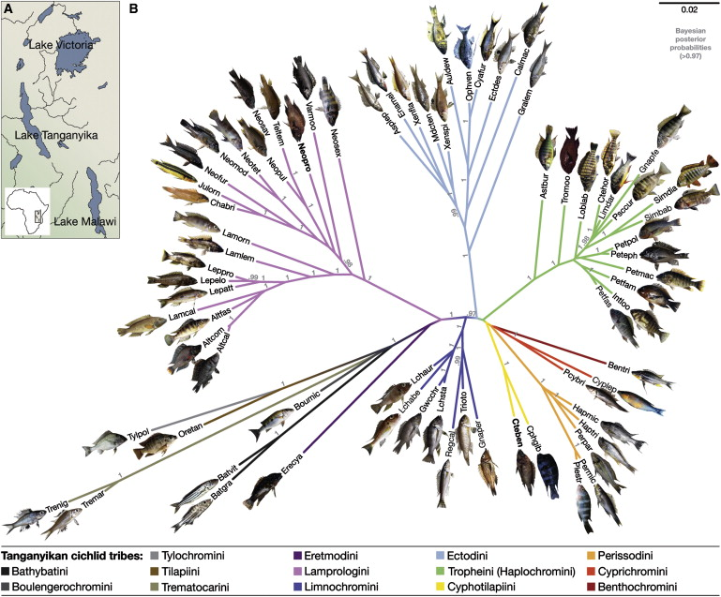
Recap: Define adaptive radiation
The process by which a species rapidly diversifies into many taxa with differing adaptations; it can be triggered by many factors, such as the emergence of reproductive barriers within a population, changes in the availability of resources, new challenges or new opportunities; it is a type of divergent evolution
Cichlid fish adaptive radiation is characterized by rapid speciation without geographical isolation.
In Lake Victoria, several hundred endemic species emerged within the past 15,000–100,000 years
https://www.youtube.com/watch?v=cY5z1dN_Svg 9 mins

Slide 25
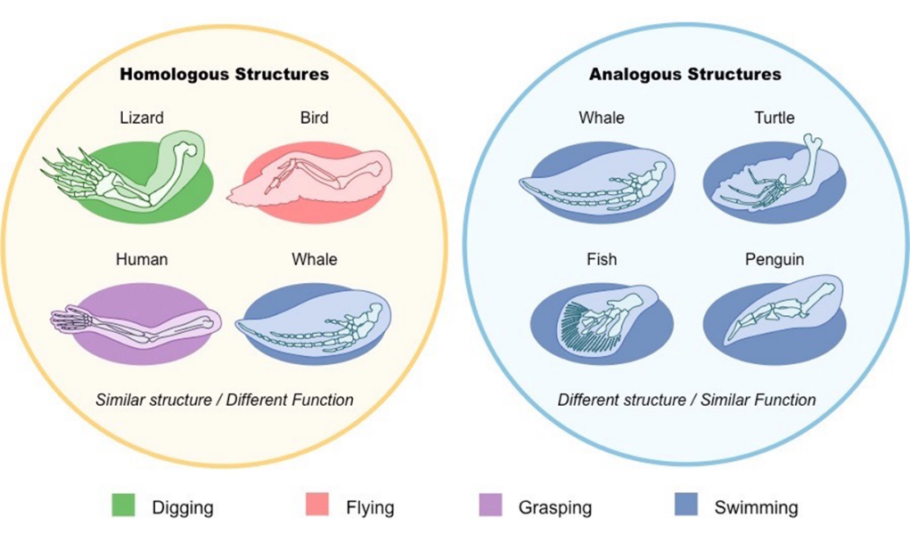
Topic Question 8: Using examples, explain how Analogous structures provides evidence for convergent evolutionc
Analogous structures are features of organisms that have the same function but not the same basic structure , therefore they do not share a common ancestor, suggests separate lines of evolution.
This is Convergent evolution
Notes:
Examples
eyes – vertebrate and octopus eyes are very similar only having a different position of optic nerve fibres
Fins for swimming
Wings – bats, birds, insects

Slide 26
Topic Question 8: Using examples, explain how Analogous structures provides evidence for convergent evolution
Example of Analogous Structures
The eyes of octopuses and vertebrates are remarkably similar, even down to fine points of detail.
However, in the vertebrate eye, the nerve fibres lie in front of the sensory cells of the retina, whereas in the octopus eye they lie behind them.
Because of this, the vertebrate eye has a blind spot where the optic nerve emerges from it, whereas the octopus eye lacks one.
The reason for this difference lies in the ways the two eyes developed, which indicates that they are the products of two distinct lines of evolution.
Alamy Stock Photo/All Canada Photos
Photos.com/Jupiterimages

Slide 27
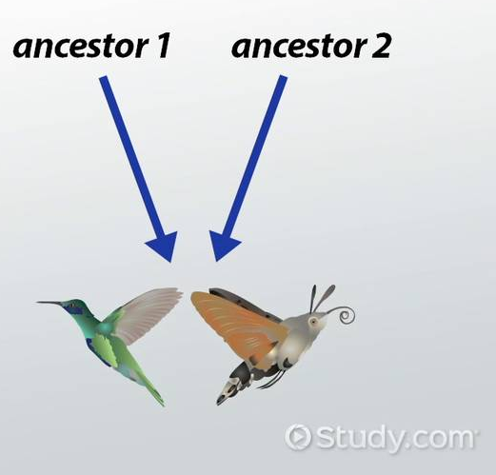
Topic Question 9: Define convergent evolution & provide examples of covergent evolution
Convergent evolution is a pattern that occurs when unrelated organisms evolve similar adaptations in response to their environment.
The results of convergent evolution often show up as analogous structures: adaptations of very different types of structures that solve a problem in a similar way.
The structures are genetically relatively different, but their functionality is very similar.

Slide 28
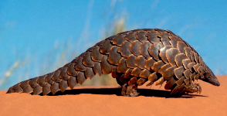
Topic Question 9: Define convergent evolution & provide examples of divergent evolution
Modern anteaters include echidnas (monotremes), numbats (marsupials), and pangolins (placentals). All of these species have an elongated snout that functions as a smelling and digging device, and a long, extendible tongue that can extract ants from crevices.
Analogous structures such as elongated snouts, are similar due to environmental pressures, not because they share a recent common ancestor. Instead, they would share a very distant common ancestor.
Alamy Stock Photo/Avalon/
Photoshot License
iStockphoto/mpot

Slide 29
Topic Question 10: define the terms, genomics, relatedness and comparative genomics
Genomics is the study of the whole set of genes of a species and the interactions of the genes within a genome. The genomes of many species have been fully sequenced. Complete genomes are now available for humans, chimpanzees, koalas and bacteria, among others.
Relatedness is a measure of evolutionary distance. The relatedness of groups of organisms is reflected in the similarity of their DNA sequences. Two species are more related if they have a more recent common ancestor and less related if they have a less recent common ancestor.
Comparative genomics is a field of biological research in which researchers use a variety of tools to compare the entire genome sequences of different species. The more similar in sequence the genes and genomes of two species are, the more closely related those species are.

Slide 30
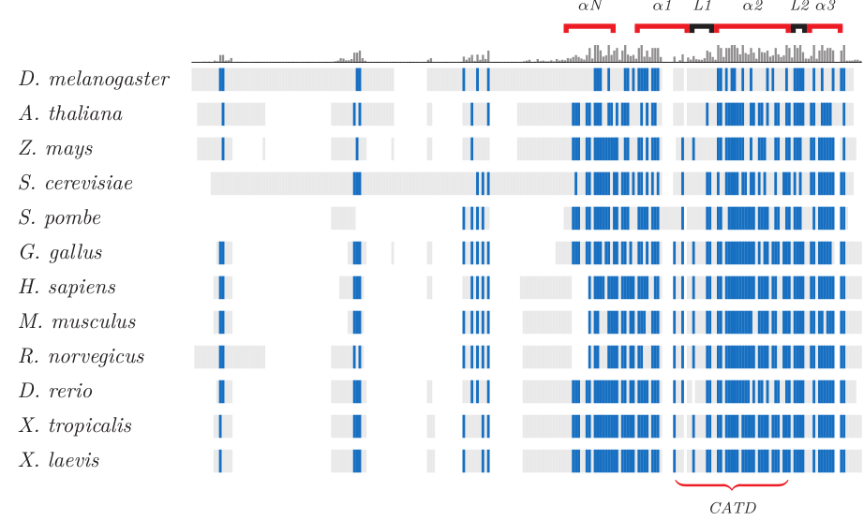
Molecular homology
All living organisms share the same genetic code, which suggests that it is a very successful way of transmitting hereditary information and is highly conserved.
Proteins are often conserved if their structure is well suited to their function, even while species evolve.
An example is histone proteins, whose function is the same across different species.
In this figure, the sequence of a histone protein is compared across different species and conserved amino acids marked in blue.
http://www.incenp.org/research/cenpa.html

Slide 31
Molecular homology
Mutations arise in DNA at a fairly constant rate, the mutation rate, which varies across species.
The mutation rate for humans is approximately 10⁻⁸ per nucleotide per generation.
Comparing the number of mutations in a DNA sequence can give an estimation of the time since two species diverged.

Slide 32
Topic Question 11: Using examples, explain how is Comparative genomics provides evidence for the theory of evolution
Large amounts of DNA sequence data is compared in an aim to reveal homologous DNA Sequences between organisms
Used to identify similarities/differences in DNA sequences between different species
Can also be used to gain an understanding of the DNA sequences that are unique to a particular group, meaning genes that are unique to a particular group and control particular traits
This can show the rate of mutation from a common ancestor
and be used to deduce evolutionary relationships and show when traits evolved or how traits changed over time

Slide 33
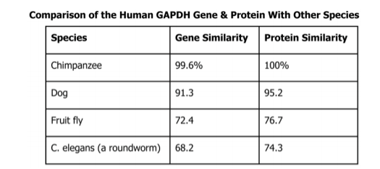
Topic Question 11: Using examples, explain how is Comparative genomics provides evidence for the theory of evolution
Greater similarity in molecular sequences of DNA and proteins reflects greater closeness of relationships and demonstrates progression of form and complexity over time.
There is a high degree of similarity of DNA in the primate group indicating that they evolved from a common ancestor
For example human and chimpanzee show a high % of relatedness with 97.5% similarity in DNA sequence
The fact that Genetic code is almost universal implies that all organisms descended from a common ancestor

Slide 34
Topic Question 11: Using examples, explain how is Comparative genomics provides evidence for the theory of evolution
Comparative genomics
DNA
Mitochondrial
  Mutation rate high (greater than nuclear DNA).
  mtDNA abundant in cells
  mtDNA inherited from maternal line only. (no recombination as only inherited from mother)
Chloroplast

Slide 35
Topic Question 12: Using examples, explain how is Comparative Biochemistry provides evidence for the theory of evolution
Comparative biochemistry is the study of different kinds of proteins (including enzymes) and their fundamental units (amino acids). It involves analysis of the similarities and differences, and the results enable evolutionary biologists to determine the degree of relatedness between species.

Slide 36
Topic Question 12: Using examples, explain how is Comparative Biochemistry provides evidence for the theory of evolution
Define Comparative Biochemistry
Comparing amino acid sequences of a protein shared between different species
Why compare Proteins?
Proteins, and the alleles that encode them, are subject to the same mechanisms of evolution as the larger traits that individuals possess.
A protein that is well suited to its function will be conserved, while other traits around it may evolve.
Proteins consist of long chains of amino acids, and each protein differs in the number, type and sequence of its amino acids.
The number of differences is used to determine the relationship between organisms.

Slide 37
Topic Question 12: Using examples, explain how is Comparative Biochemistry provides evidence for the theory of evolution
Comparative Biochemistry shows evidence of evolution
Sequence of amino acids in a protein is determined by a DNA sequence
The more similar the amino acids, the more similar the DNA sequence
Organisms with similar DNA/amino acid sequences are closely related
This is because they diverged more recently (share a more recent common ancestor)
So there has been less time to accumulate mutations or differences in DNA sequence
Commonly studied proteins include
haemoglobin (blood protein)
cytochrome C (respiratory protein)a protein involved in the synthesis of ATP in the mitochondria)

Slide 38
Topic Question 12: Using examples, explain how is Comparative Biochemistry provides evidence for the theory of evolution
Specific example of comparative biochemistry
The differences in sequence of the 146 amino acids that make up the blood protein haemoglobin are an indicator of the closeness of the relationships between humans and other primates.
Primate | No. of differences in amino acid sequence
Chimpanzee | 0
Gorilla | 1
Gibbon | 3
Orangutan | 4
Macaque (monkey) | 8
Lemur | 5

Slide 39
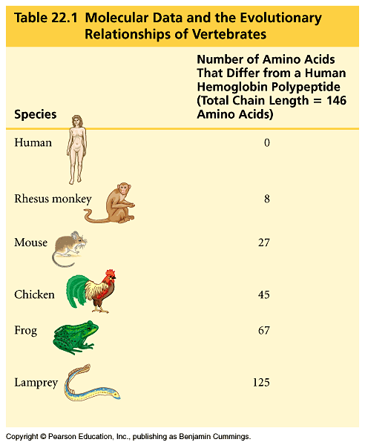

Slide 40
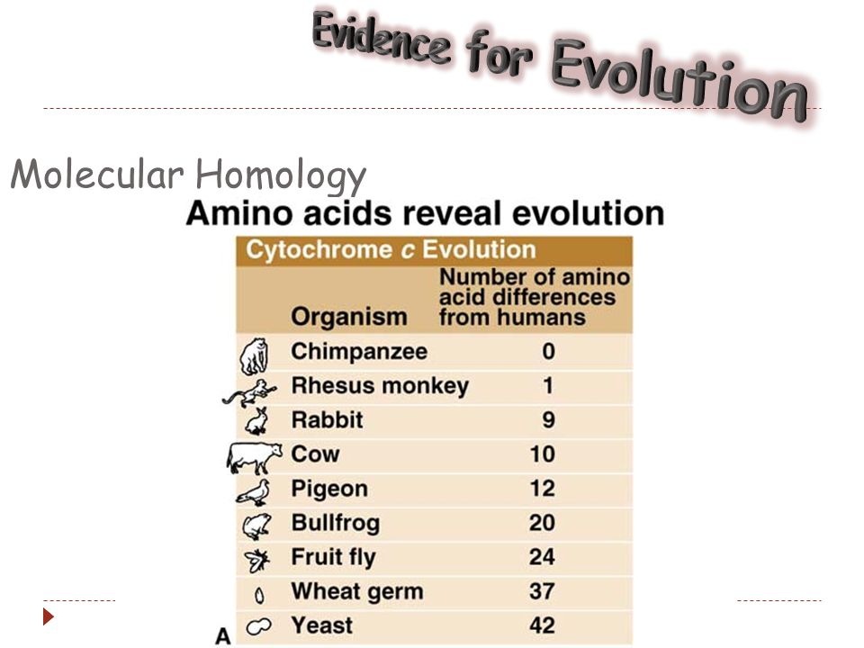

Slide 41
Practice Question

Slide 42
Syllabus
Syllabus:
Technological developments in the fields of comparative genomics, comparative biochemistry and bioinformatics have enabled identification of further evidence for evolutionary relationships (SHE)
Developments in bioinformatics DNA sequencing technology are allowing biologists to use comparative genomics and biochemistry to develop an in-depth understanding of evolution
Essential
Question:

Slide 43
DNA sequencing (next generation or Sanger) and DNA-DNA hybridisation are molecular methods used by scientists to measure relatedness.

Slide 44
Molecular methods
Through variation in DNA or RNA sequences, scientists can obtain a measure of the difference between organisms and trace evolutionary relationships.
They can, for example, detect subtle differences in base sequences between two microbes.

Slide 45
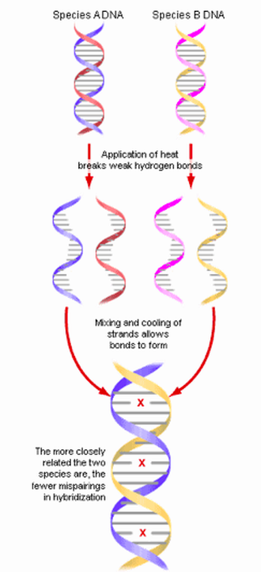
Topic Question 1: describe how dna hybridisation is used to provide evidence of evolution
Measures the degree of genetic similarity between complementary DNA sequences
Process of joining 2 single strands of DNA from 2 different species to form a hybrid DNA
Closely related species have very few differences in their genome compared to distantly related species
More bonds in complementary strands will form the more closely related the DNA sequences

Slide 46
Topic Question 1: describe how dna hybridisation is used to provide evidence of evolution
Complementary DNA strands of the species to be compared are denatured by heating to break hydrogen bonds between base pairs
Single-stranded DNA molecules from species being compared are mixed together & allowed to cool
Similar strands of DNA from the different species will begin to anneal at complementary base pairs via hydrogen bonds

Slide 47
Topic Question 1: describe how dna hybridisation is used to provide evidence of evolution
The resulting hybrid DNA is then reheated
The temperature at which hybrid DNA separation occurs is related to the number of hydrogen bonds that have formed between complementary base pairs
Closely related species will have temperature separation close to the temperature required to break the hydrogen bonds initially (high temperatures)

Slide 48
Topic Question 1: describe how dna hybridisation is used to provide evidence of evolution
If the species is not closely related, less base pairing occurs
The temperature required to separate the hybrid DNA molecule will be lower than the initial temperature
This information can be compared with known fossil dates & used to estimated the approximate date that the species diverged

Slide 49
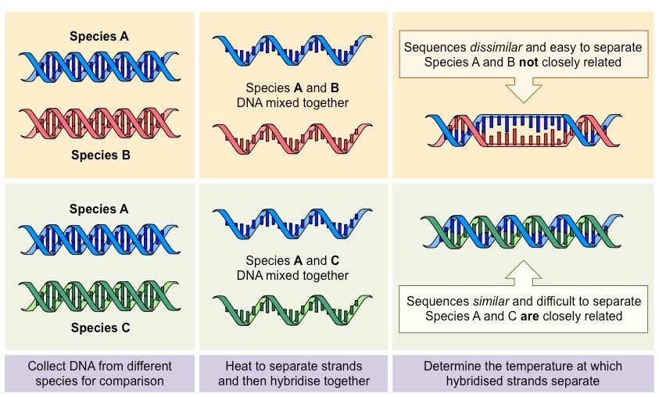

Slide 50
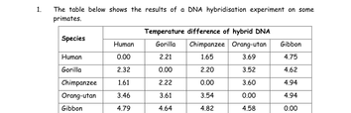
Topic Question 1: describe how dna hybridisation is used to provide evidence of evolution
Based on the table, which species are most closely related to humans and why?

Slide 51
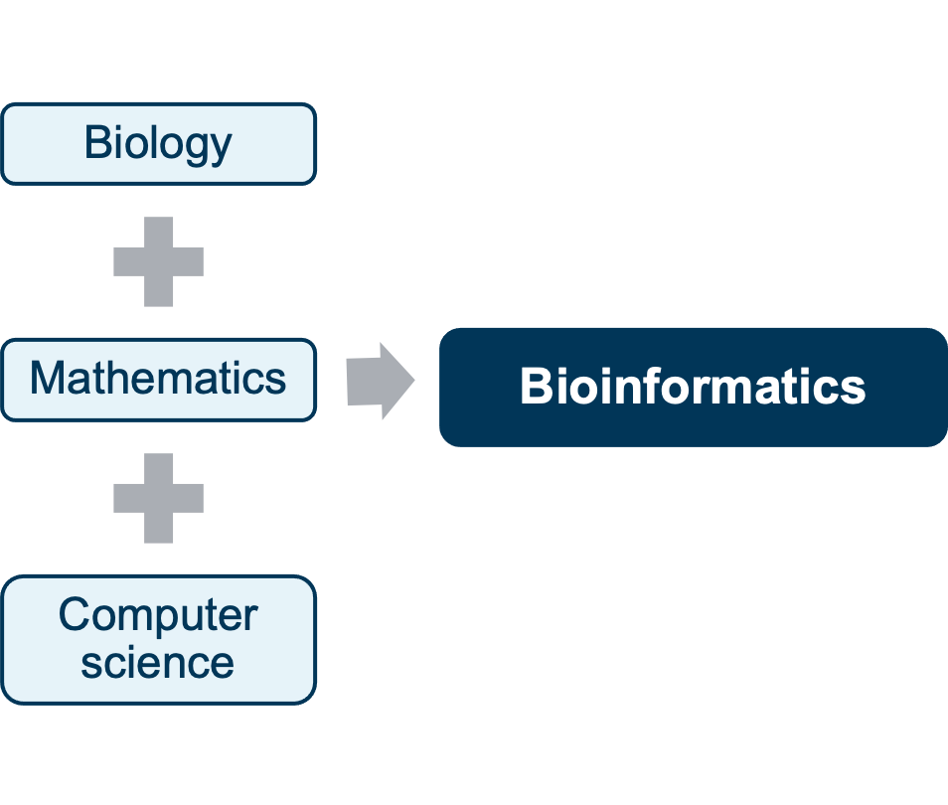
Topic Question 2: define bioinformatics

Slide 52
Topic Question 3: define bioinformatics
Bioinformatics is the digital storage, retrieval, organisation and analysis of an enormous volume of biological data.
It applies mathematics and computers to the study of problems in biology
Bioinformatics has dramatically increased the size, accuracy and scope of data sets, such as those needed for comparative genomics.

Slide 53
Topic Question 4: explain why bioinformatics is important in the field of comparative genomics
Comparative genomics produces very large data sets
Specialised computing software is required to analyse these data sets
Bioinformatics is needed to analyse and store such large data sets because traditional methods are not capable of storing or analysing such large data sets
Bioinformatics has provided significant advances in our knowledge of the entire genomes of organisms, and in turn this has revealed yet more evidence of evolution.

Slide 54
Syllabus
Syllabus:
Evolutionary relationships between groups can be represented using phylogenetic trees
Draw and analyse a phylogenetic tree
Essential
Question:

Slide 55
Topic Question 1: describe what a phylogenetic tree is and what this kind of flow diagram shows
Evolutionary relationships between groups can be represented using phylogenetic trees.
These diagrams show how organisms are related to each other but the tree
is a hypothesis, not a certain fact.
A phylogenetic tree can be built using:
• physical information, such as body shape, bone structure or behaviour
• molecular information, such as genetic sequences.

Slide 56
Topic Question 1: describe what a phylogenetic tree is and what this kind of flow diagram shows
The recent species are at the end of the branches
Shared common ancestor are at the root

Slide 57
Topic Question 3: Label the parts of a phylogenetic tree
Nodes represent a common ancestor
Branch length represent divergence time
Closely related species will be grouped in the same part of the tree or clade

Slide 58
Topic Question 3: draw a phylogenetic tree

Slide 63
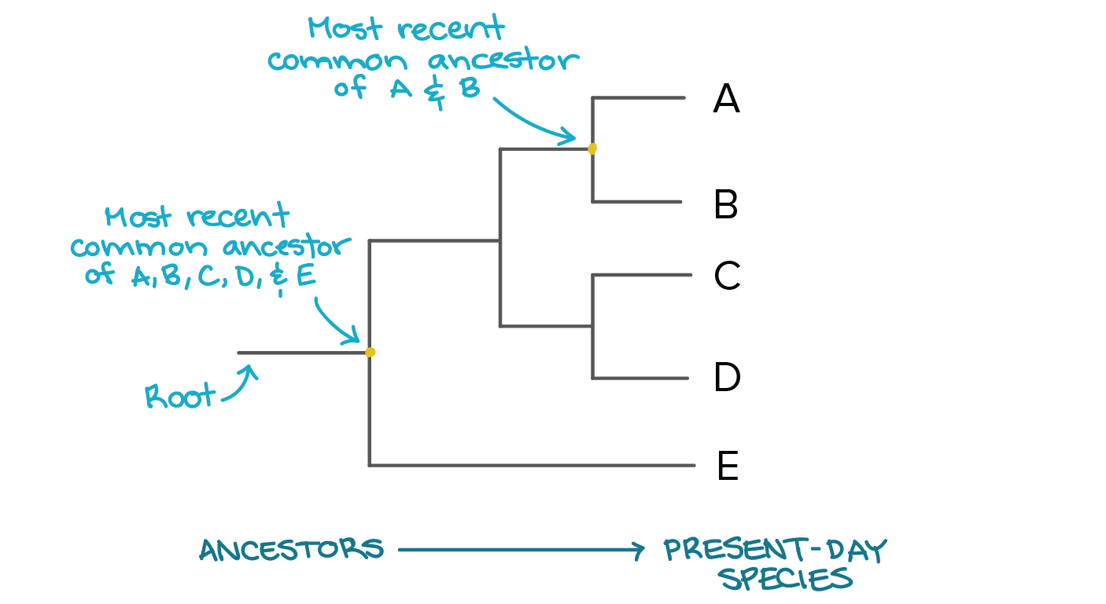
Topic Question 4: analyse a phylogenetic tree

Slide 64
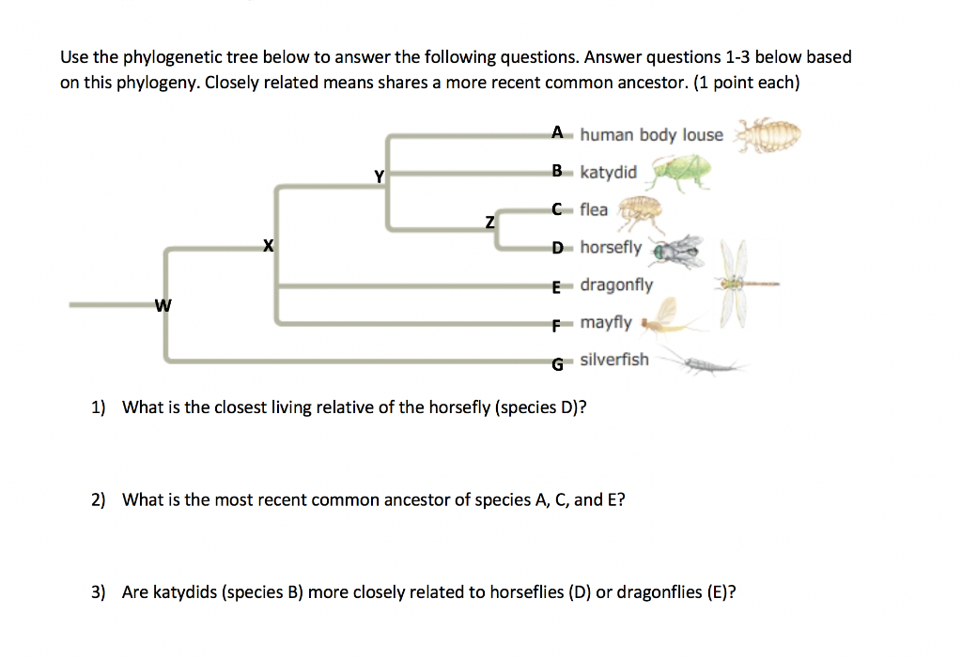
Topic Question 4: analyse a phylogenetic tree

Slide 65
Evidence of Evolution Videos
https://www.youtube.com/watch?v=Q-aGAX27SIo
https://www.youtube.com/watch?v=O21VOcLIb3M
https://www.youtube.com/watch?v=lIEoO5KdPvg

